Slide 1
8-Instance Types

Slide 2
Amazon EC2 Instance Types
Amazon EC2 provides a wide selection of instance types optimized to fit different use cases.
Instance types comprise varying combinations of CPU, memory, storage, and networking capacity and give you the flexibility to choose the appropriate mix of resources for your applications.
Each instance type includes one or more instance sizes, allowing you to scale your resources to the requirements of your target workload.

Slide 3
Amazon EC2 Instance Types
We have few types of the instances available, those categorized into the following.
General Purpose
General purpose instances provide a balance of compute, memory and networking resources, and can be used for a variety of diverse workloads. These instances are ideal for applications that use these resources in equal proportions such as web servers and code repositories.
Compute Optimized
Compute Optimized instances are ideal for compute bound applications that benefit from high performance processors. Instances belonging to this family are well suited for batch processing workloads, media transcoding, high performance web servers, high performance computing (HPC), scientific modeling, dedicated gaming servers and ad server engines, machine learning inference and other compute intensive applications.Memory Optimized
Memory optimized instances are designed to deliver fast performance for workloads that process large data sets in memory.
Accelerated Computing
Accelerated computing instances use hardware accelerators, or co-processors, to perform functions, such as floating-point number calculations, graphics processing, or data pattern matching, more efficiently than is possible in software running on CPUs
Storage Optimized
Storage optimized instances are designed for workloads that require high, sequential read and write access to very large data sets on local storage. They are optimized to deliver tens of thousands of low-latency, random I/O operations per second (IOPS) to applications.
You can check the full list of the instance types from the below URL
Reference link: https://aws.amazon.com/ec2/instance-types/

Slide 4
Change Instance Type
We can change instance types from one type to another with few clicks, but there is down time involved here because we must shut down the instance to change instance type.
To change the instance type, select your instance and go to actions then instance state then stop.

Slide 5
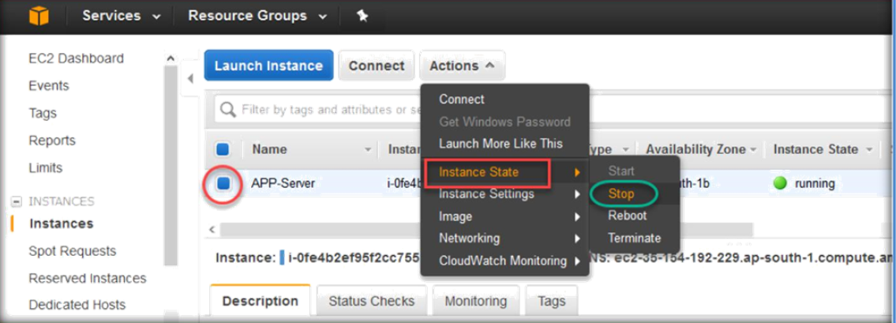
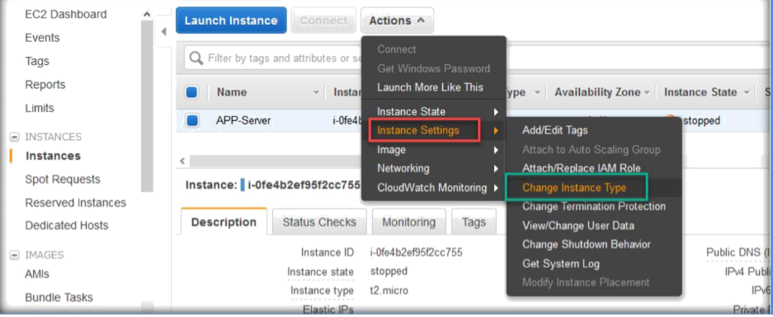
Once the instance has stopped, make sure you select the instance and go to Actions tab, expand Instance Settings, then choose Change Instance Type.

Slide 6
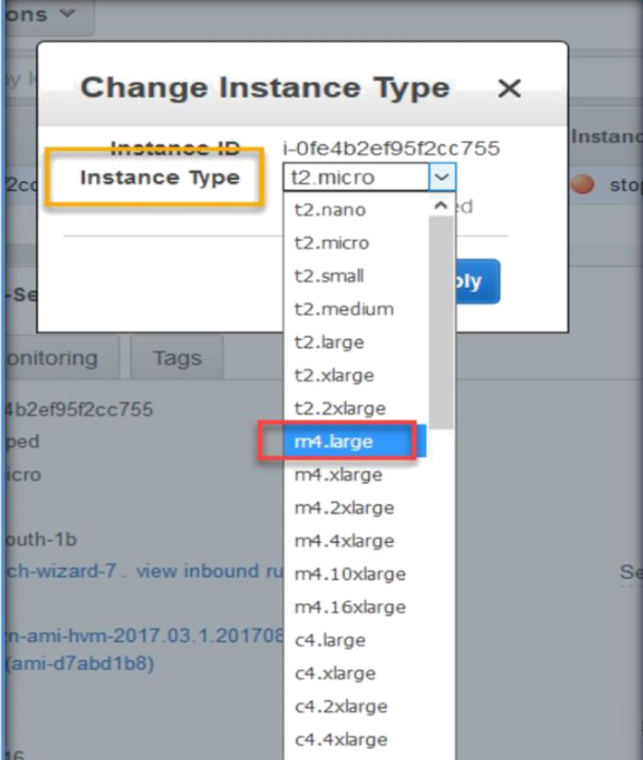
Next, Change instance type wizard will open, choose the new instance type from instance type drop down list.
Next, clck on apply.

Slide 7
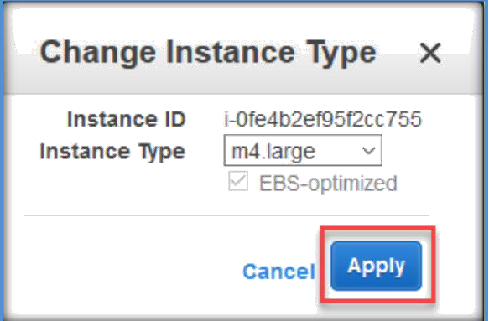
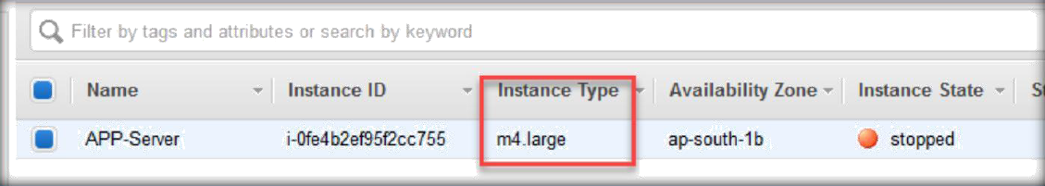
Now, you can able to see the new instance for the instance under the instance type tab.
Now you can start the instance and it will start with the new m4.large CPU and RAM configuration.

Slide 8
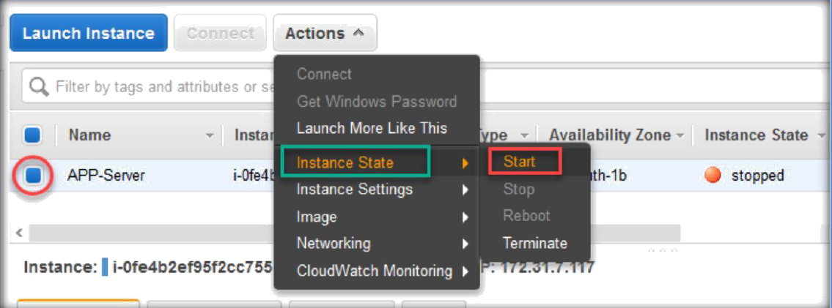

Slide 9


